Slide 1
Gaussian Processes
Bruce Sharpe

Slide 2
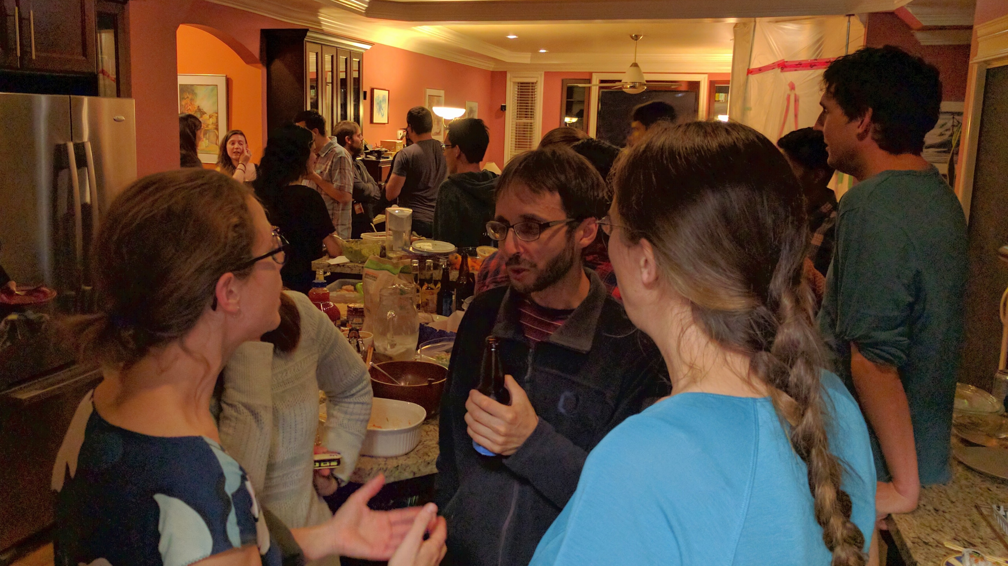

Slide 3
My questions for any new technique
what problems do they solve?
disadvantages / what problems do they not solve?
can I get some Python code working?
what is the motivation for how they work?
what is the "hello world" example?
what are the definitions? assumptions? theorems?
how do you know when to use them?
are there famous examples where they were used?
what is the motivation for how they work?
has it won any Kaggle competitions?
is there a YouTube video so I don't have to read the paper?
can I even understand the Wikipedia page?

Slide 4
My questions for any new technique
what problems do they solve?
disadvantages / what problems do they not solve?
can I get some Python code working?
what is the motivation for how they work?
what is the "hello world" example?
what are the definitions? assumptions? theorems?
how do you know when to use them?
are there famous examples where they were used?
what is the motivation for how they work?
has it won any Kaggle competitions?
is there a YouTube video so I don't have to read the paper?
can I even understand the Wikipedia page?

Slide 5
Approaches to GPs
State space <= most treatments start here
Function space <= I prefer this

Slide 6
What problems do they solve?
Regression
Classification
Optimization

Slide 7
What problems do they solve?
Regression (especially things like time series)
Classification
Optimization

Slide 8
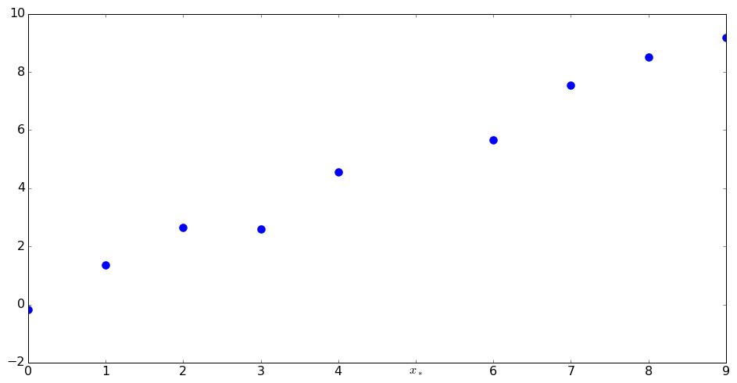
What regression problems do they solve?

Slide 9
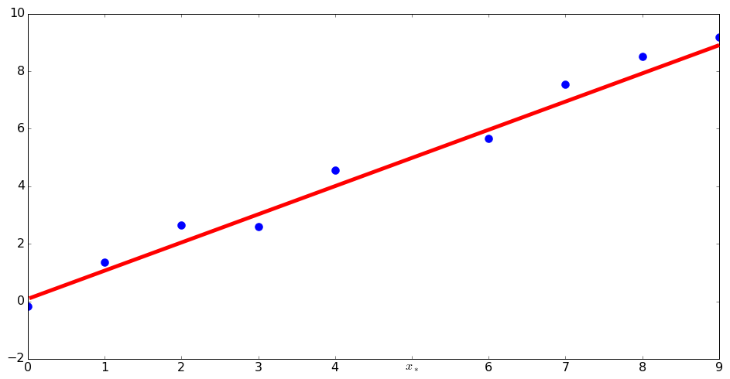
What regression problems do they solve?
y = mx + b

Slide 10
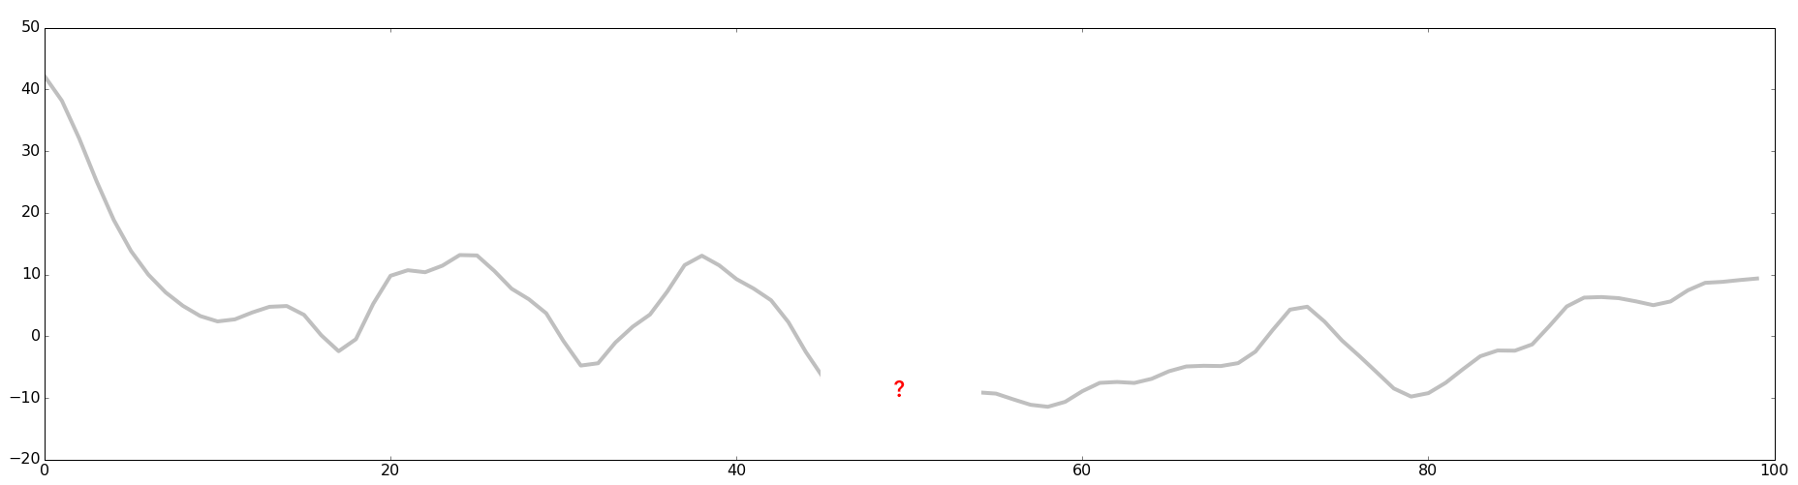

What regression problems do they solve?
$$x_{∗}$$

Slide 11

What regression problems do they solve?

Slide 12
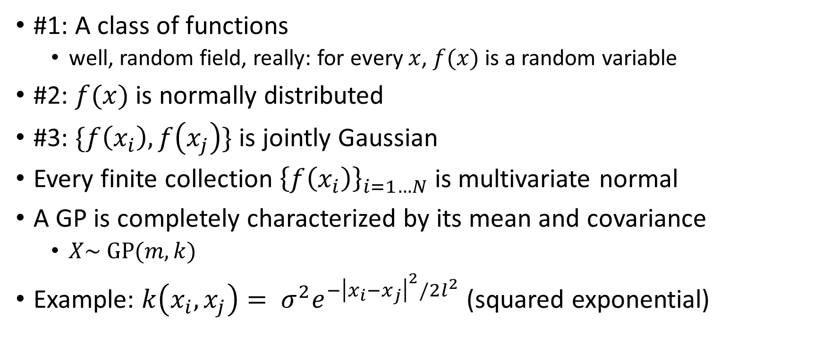
Let’s narrow down the possibilities
#1: A class of functions
well, random field, really: for every $x$, $f(x)$ is a random variable
#2: $f(x)$ is normally distributed
#3: $\{f\left(x_{i}\right), f\left(x_{j}\right)\}$ is jointly Gaussian
Every finite collection ${\left\{f\left(x_{i}\right)\right\}}_{i=1…N}$ is multivariate normal
A GP is completely characterized by its mean and covariance
$X\sim \text{GP}(m, k)$
Example: $k\left(x_{i}, x_{j}\right)= σ^{2}e^{−{\left|x_{i}−x_{j}\right|}^{2}/2l^{2}}$ (squared exponential)

Slide 13
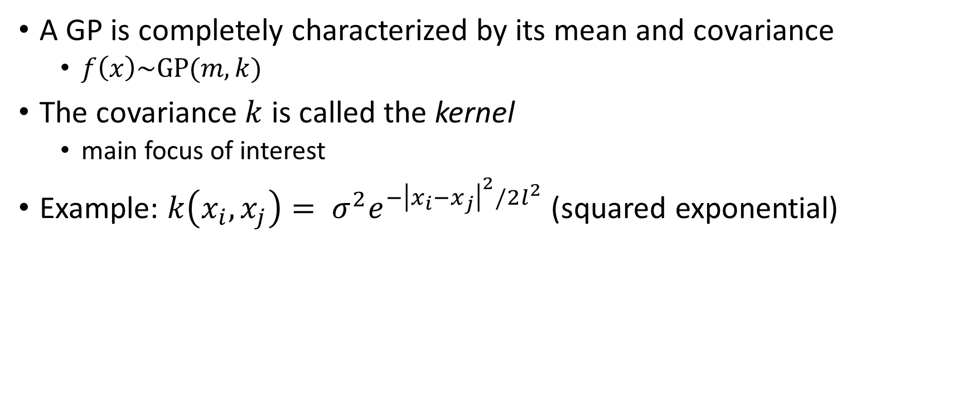
Slightly less mysterious (?)
A GP is completely characterized by its mean and covariance
$f\left(x\right)\sim \text{GP}(m, k)$
The covariance $k$ is called the kernel
main focus of interest
Example: $k\left(x_{i}, x_{j}\right)= σ^{2}e^{−{\left|x_{i}−x_{j}\right|}^{2}/2l^{2}}$ (squared exponential)

Slide 14
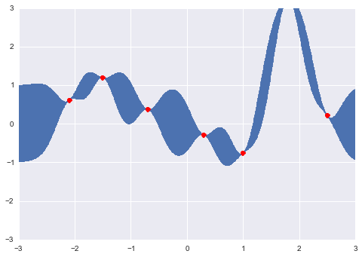

Back to regression (prediction)
Compute $f\left(x_{∗}\right)$ given some observations $(x_{i}, y_{i})$
We can calculate the posterior distribution (Bayes)
Given the magic of normal distributions, can get analytical results

Slide 15
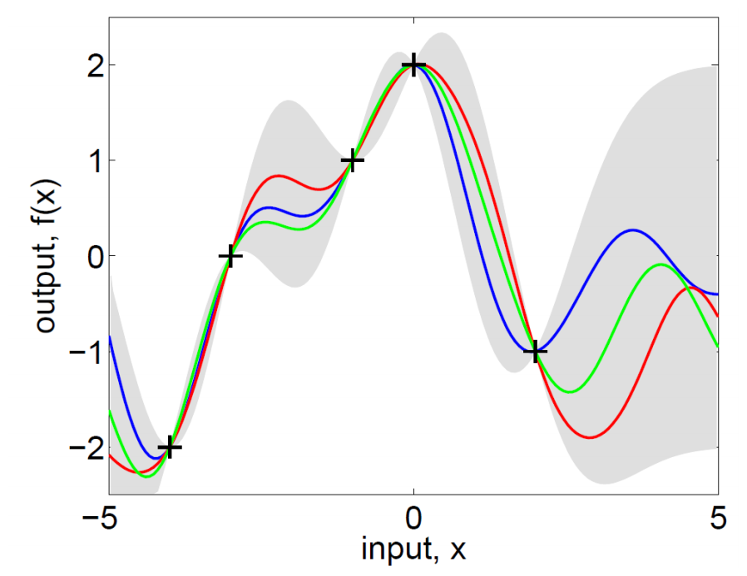

Slide 16
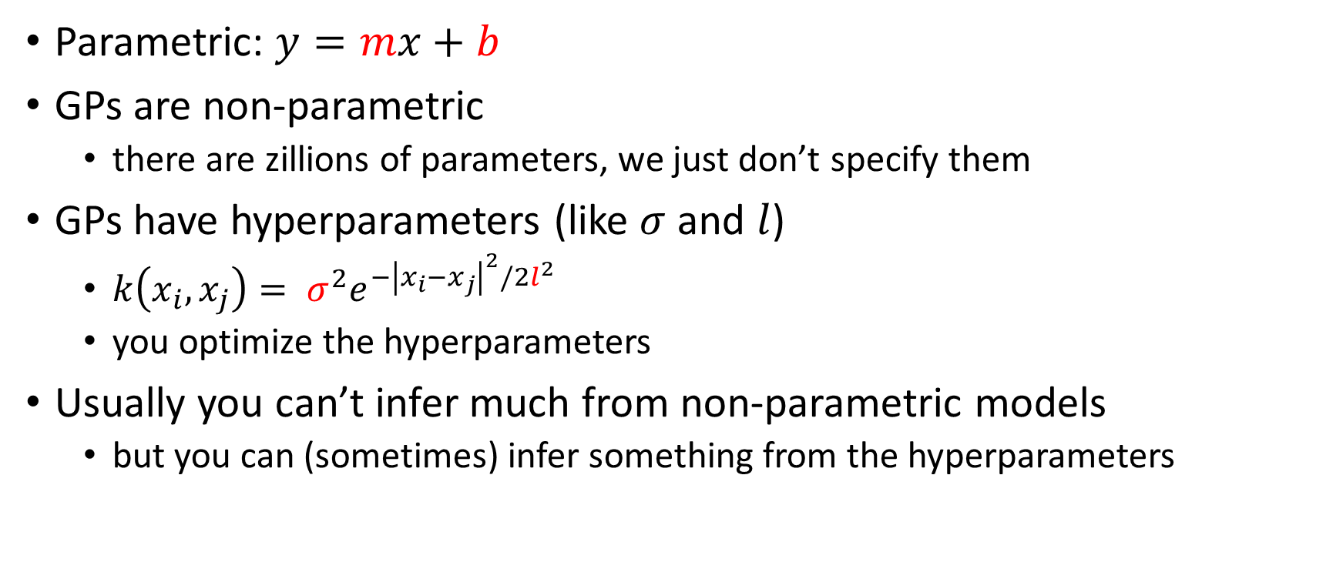
Parametric vs non-parametric
Parametric: $y=mx+b$
GPs are non-parametric
there are zillions of parameters, we just don’t specify them
GPs have hyperparameters (like $σ$ and $l$)
$k\left(x_{i}, x_{j}\right)= σ^{2}e^{−{\left|x_{i}−x_{j}\right|}^{2}/2l^{2}}$
you optimize the hyperparameters
Usually you can’t infer much from non-parametric models
but you can (sometimes) infer something from the hyperparameters

Slide 17
The paper
“Principled”? Hmm…
Changepoints: cool!
Examples: pretty good!

Slide 18
Questions
Can you use an experimentally determined covariance rather than an analytical form?
GP for big data? (sparse approximations?)

Slide 19
My big fat dumb GP

Slide 20
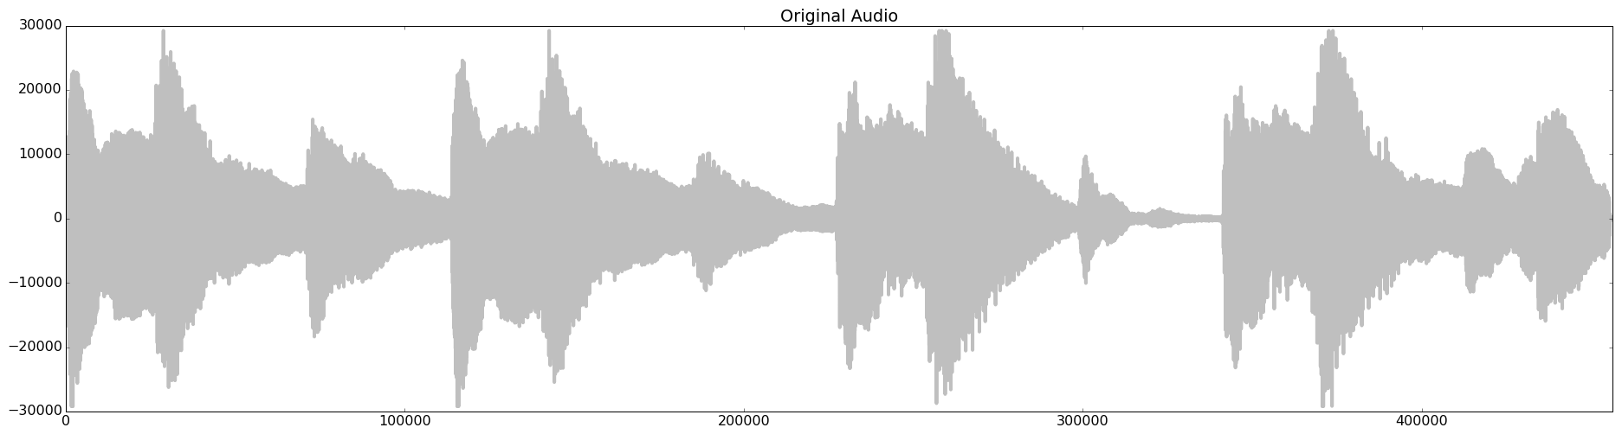
Audio

Slide 21
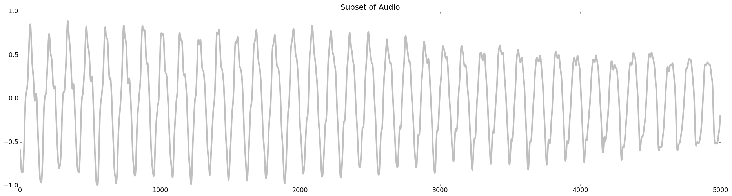
Ahem, let’s not blow up my memory

Slide 22
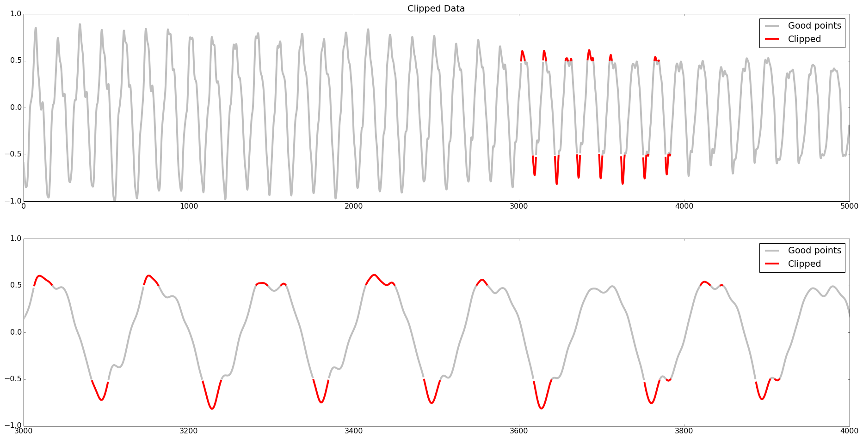
Clipping distortion

Slide 23
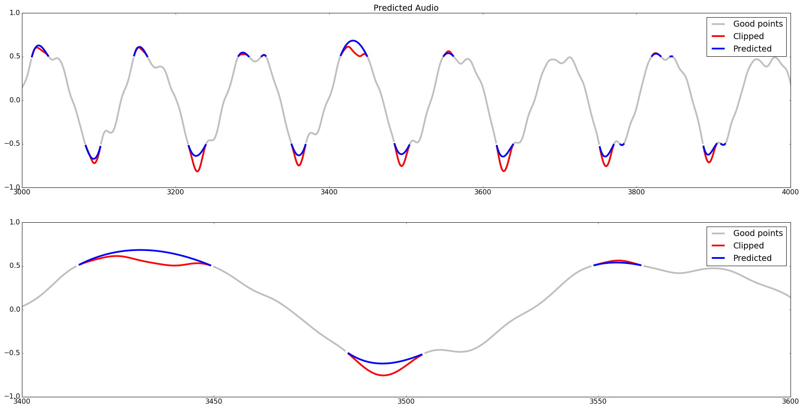
Fill in the gaps

Slide 24
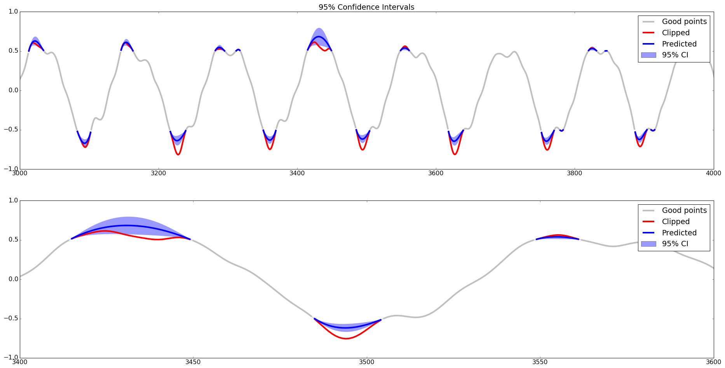
And now, with confidence

Slide 25
My big fat dumb GP #2

Slide 26
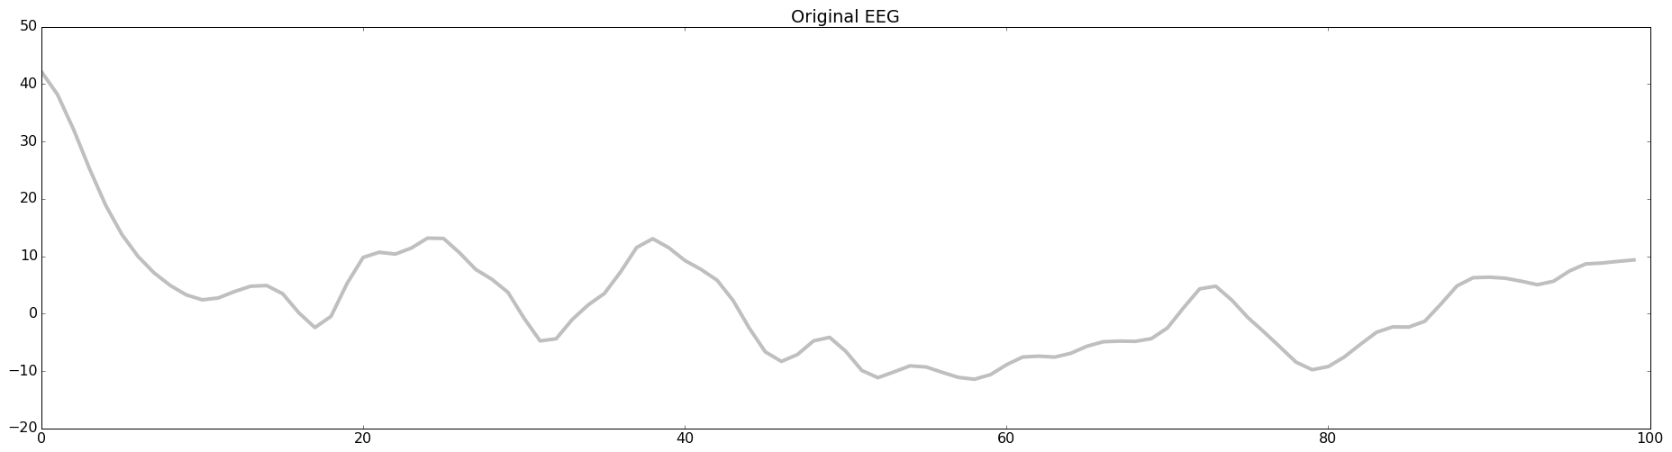
EEG data

Slide 27
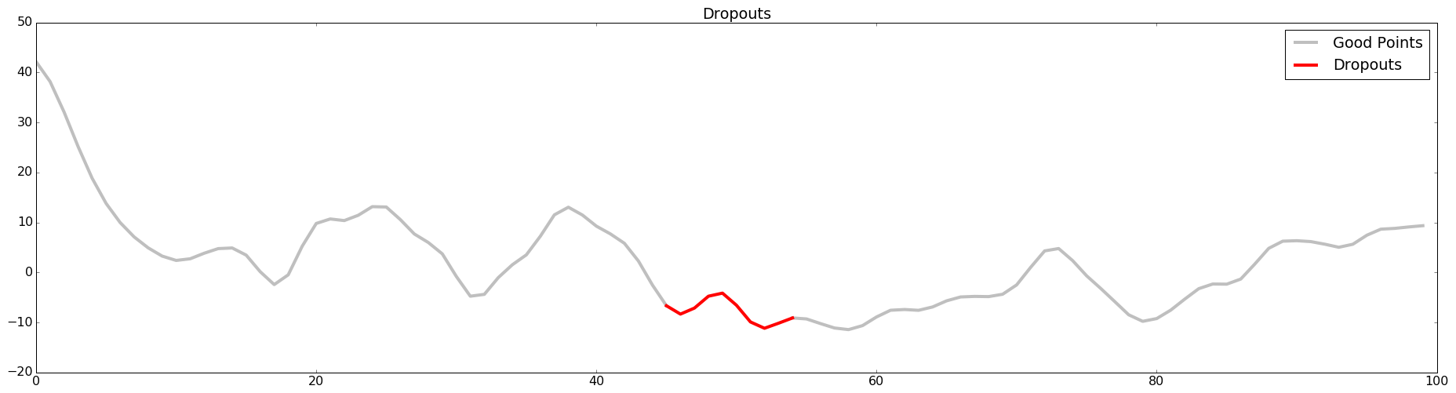
EEG data with dropouts

Slide 28
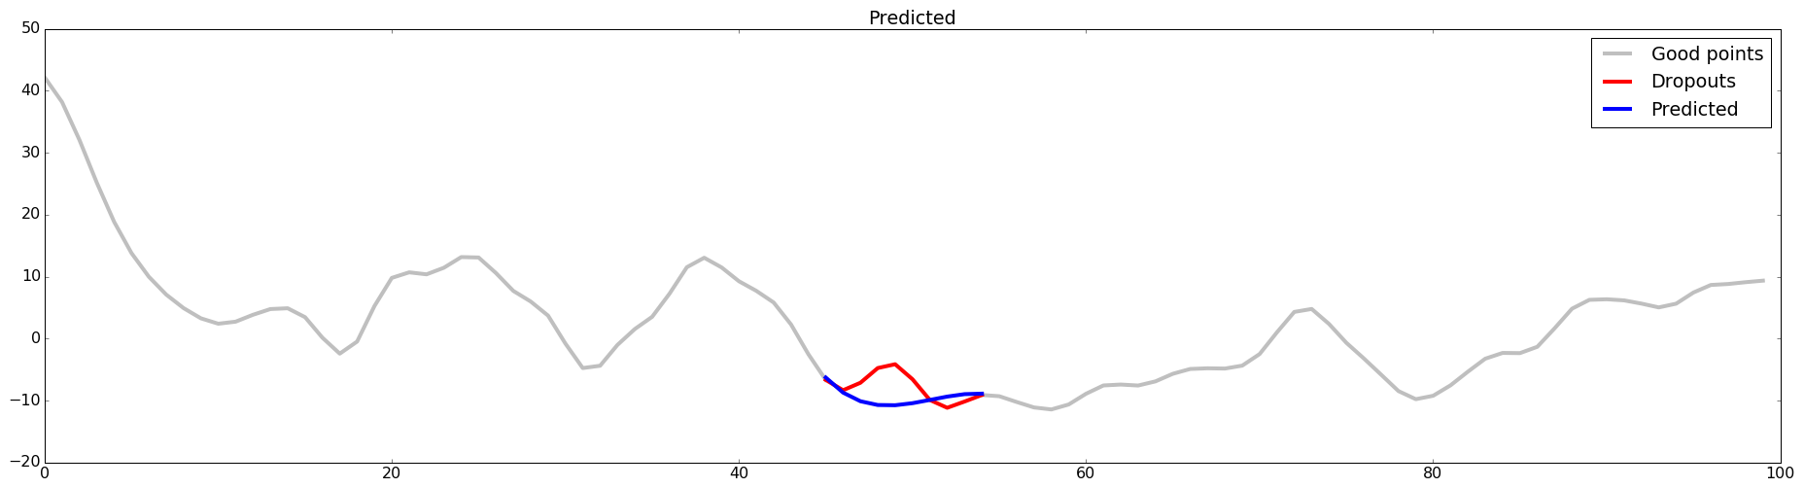
EEG data with predictions

Slide 29
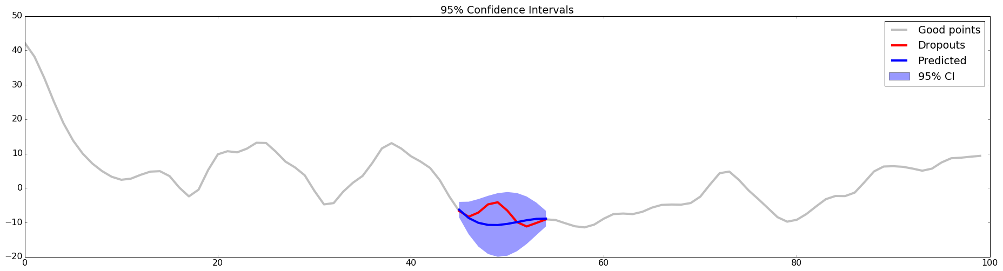
EEG data with confidence

